Slide 1

Product Attribute Based
Sentiment Analysis
Analyzing Reviews by Gen AI/LLM
Yash Jain
Data Analyst
GSCL Operations Intelligence

Slide 2


Problem Statement
Traditional product reviews often lack granularity, as they provide overall ratings without specifying attributes.
This makes it challenging for consumers and Retailers to understand the specific pros and cons of a product and why Product is getting negative review or poor rating.
Example:
[Delivery] [Customer Service]
Got this product in just 2 days. Camera is good but battery have heating issue, But People from Target help me to resolve the issue.
Rating

Slide 3


What Values this Product Brings?
Product Attributes
Retailers and Vendors will get knowledge why product is failing?
For ex: Fit, quality, Value for money, Design
Delivery Service & Customer Service
Is it because of Delivery service/Customer service product is getting negative reviews?
Guest Shopping Experience
Guest will get knowledge about pros & cons of the product.

Slide 4
How Are We Solving It?
Create a Dataset using Prompt engineering using GPT-3 (approx. 1000 Review)
Fine Tune Llama 13b using PEFT Lora Technique on generated dataset.
LLAMA 13B is Commercially available Large Language Models Like Chat GPT but its opensource i.e. It does not cost us any amount also data is completely secured.

Slide 5

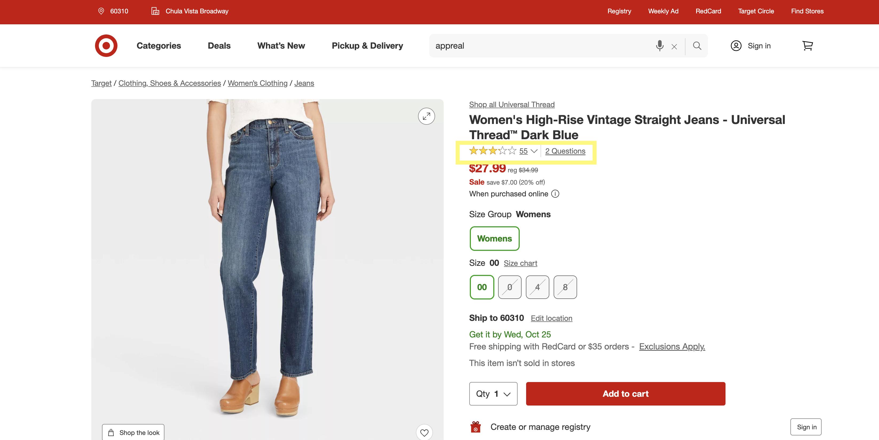
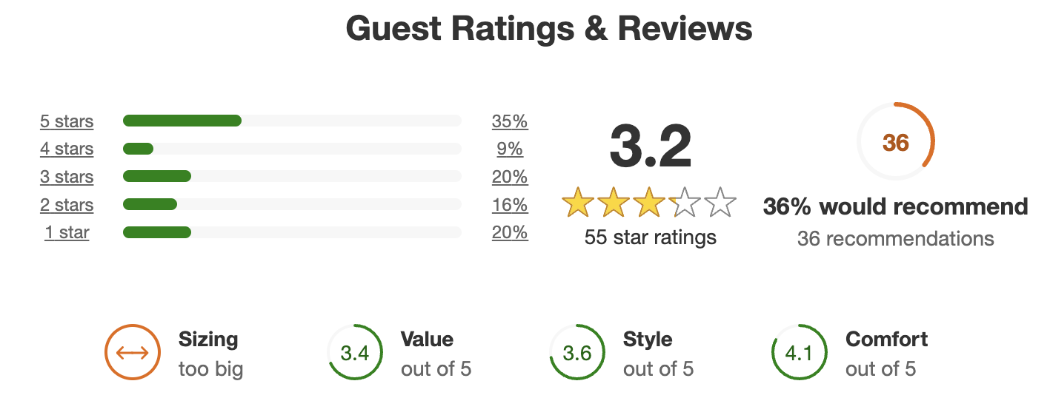
Issue in the Existing Review Analysis
Traditional Approach(Static):
We asked user to Rate the following aspect based on experience with the product.
Problem:
Why just the four aspect? What if Guest didn’t like something else.
Doesn’t give good experience to Guest to ask them to rate multiple things.

Slide 6
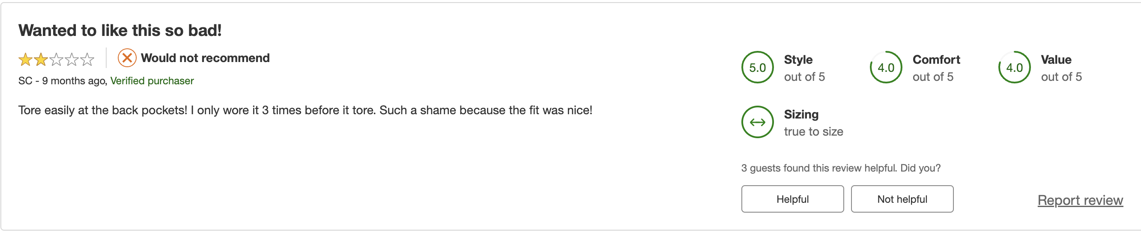
Comparison with Existing Review Analysis
Traditional Approach(Static):
Traditional approach aspect rating could be misleading, Because user would not be much interested to give manual rating on multiple things seriously.
Advance Approach( Dynamic Aspect using Gen AI & LLM):

Slide 7
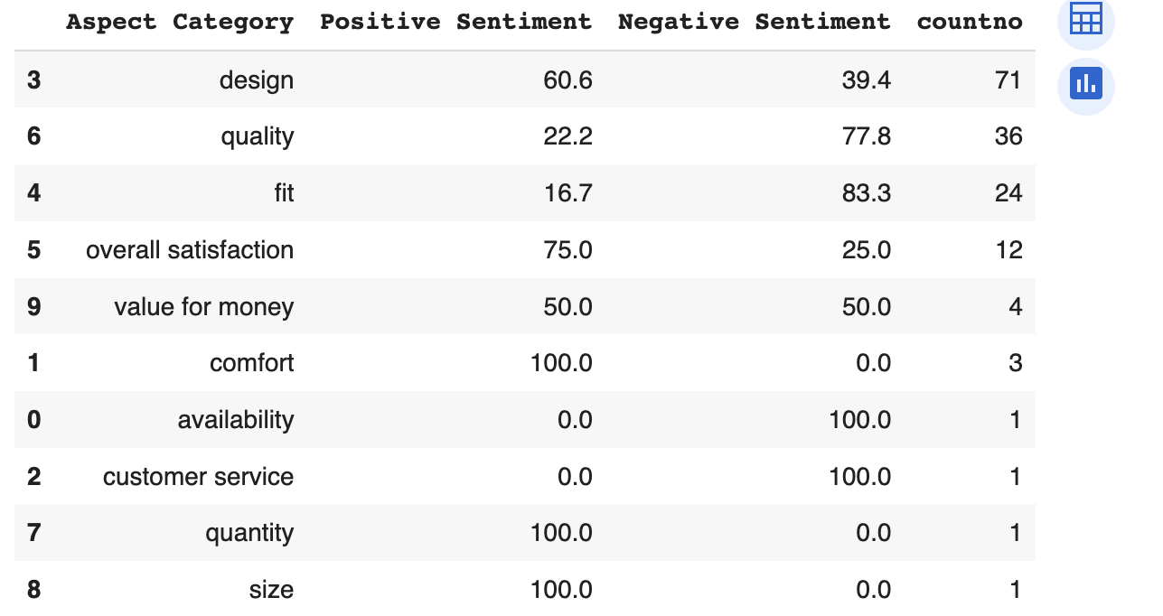
Analysis of Advance Approach:
By Analyzing all the 40 reviews of the product, It got broken up into 156 segment with 10 Aspect Category.
‘Quality’ and ‘Fit’ and ‘Design’ are the Main aspect of the product due to which product is getting poor rating and reviews.
In Traditional Approach: We have no mention of ‘Quality’.

Slide 8
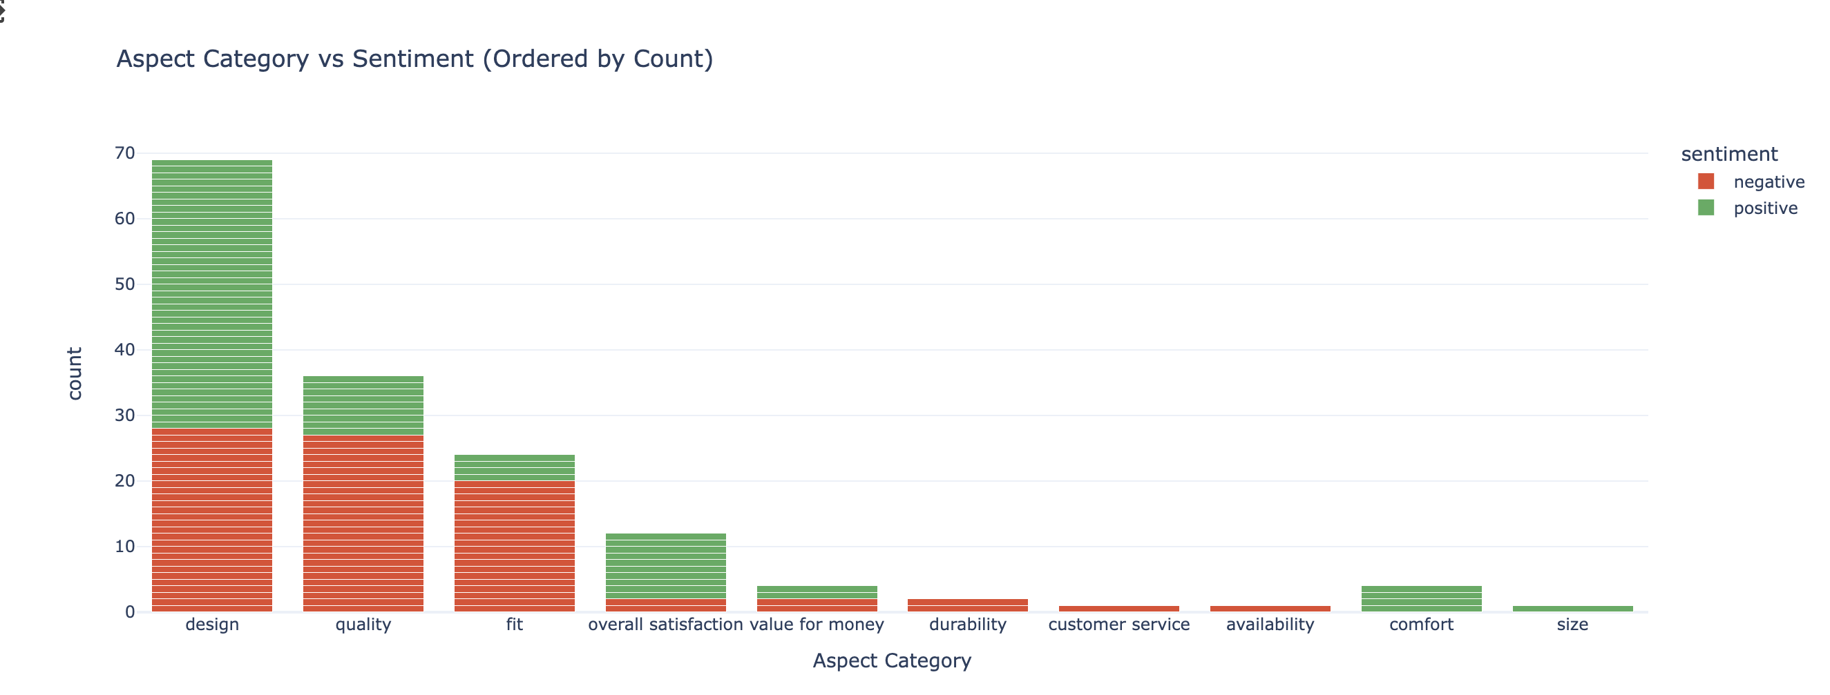
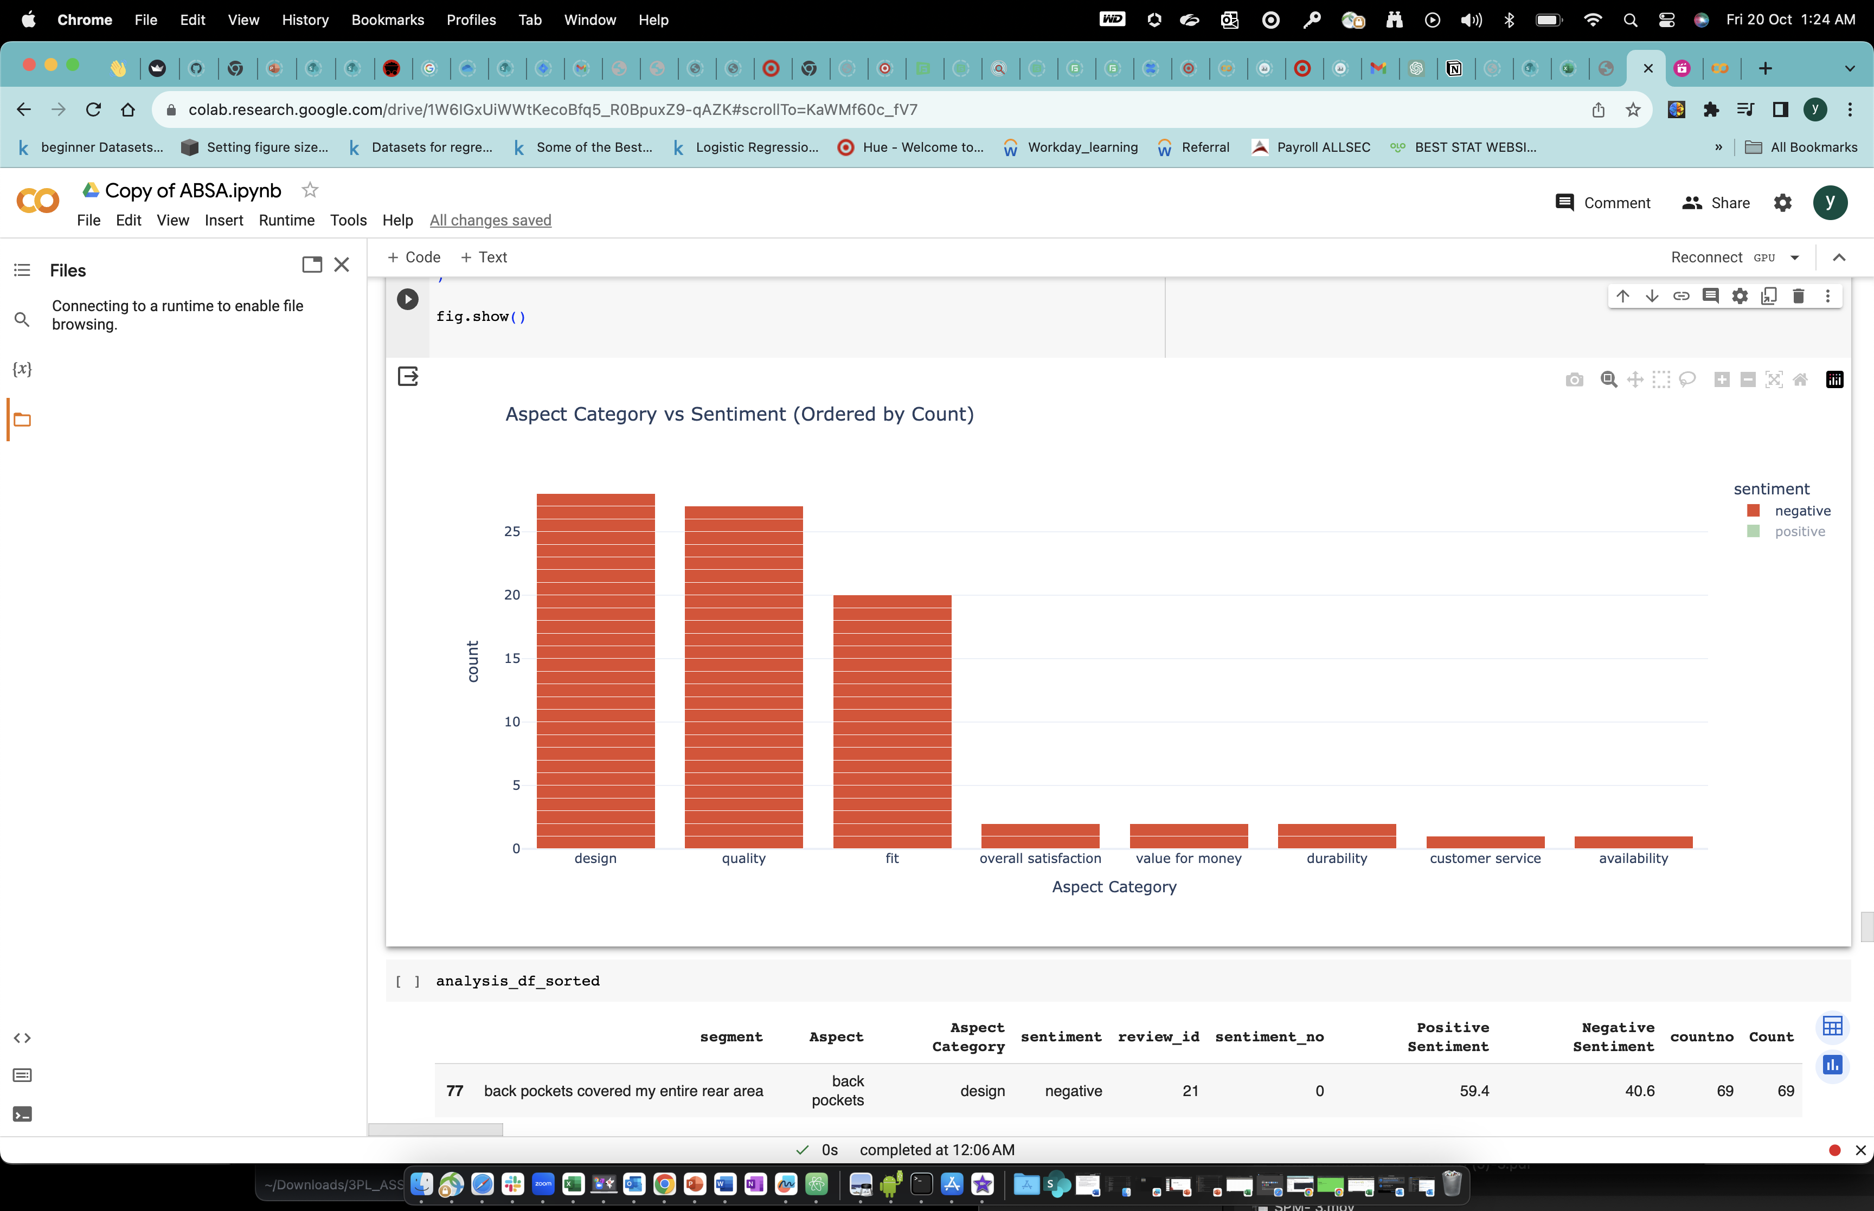
Review Insights using GenAI and LLM:

Slide 9
Key learning
Started this Project with simplistic approach by using NLP and ML, Realised LLM are truly beneficial for this problem statement and not just a hype!
Lots of opensource LLM model(Hugging Face) are available in market. So, it’s been a challenge to find the right one and evaluate its performance.

Slide 10

Early Wins
Discovered Hidden insights which lies in textual reviews.
Performance of product could be improved by analyzing and improving the factor which causing the loss of the product.
Could also brings opportunity as a ‘Pay on Service’ for vendors to discover the issue with the product.

